Slide 1
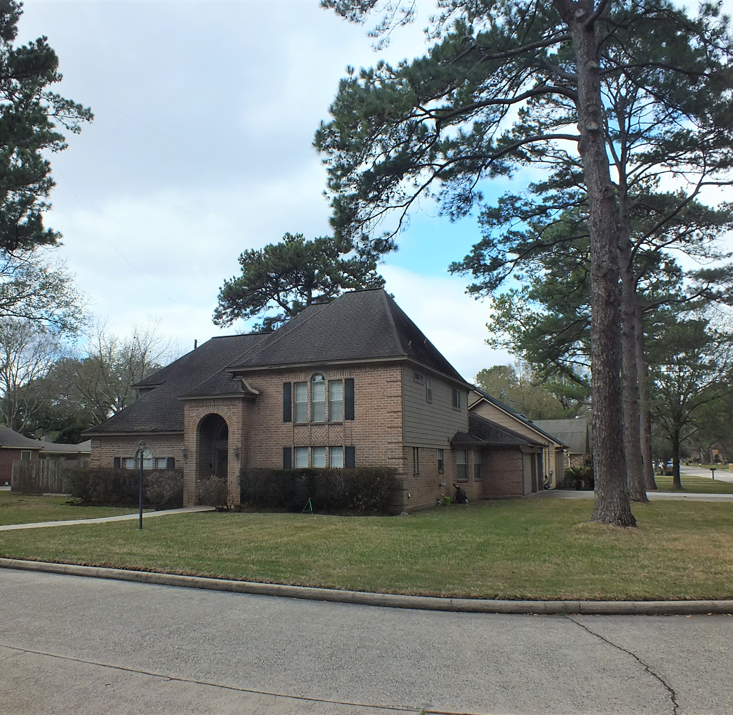
HIGH PERFORMANCE MULTI–BAND WIRE ANTENNA FOR A RESIDENTIAL LOT
BY
W5VEK

Slide 2
AVAILABLE RESOURCES ON LOT
GOOD SIZE CORNER LOT
NUMEROUS MATURE TREES LOCATED AROUND THE HOUSE
HOUSE DESIGN WITH GOOD ATTIC SPACE TO ROUTE WIRES
RADIO SHACK ON 2ND FLOOR WITH GOOD ACCESS TO ATTIC
WIFE WAS UNDERSTANDING ABOUT WIRES
LENIENT HOA

Slide 3
EARLY ANTENNNA INSTALLATIONS
VERTICAL ANTENNA 4BTV
EASY TO INTALL AND GAVE 4 BAND COVERAGE
NOISEY AT THE BEST OF TIMES
FOUND TWO PINE TREES SPACED STRATEGICALLY AND INSTALL SIMPLE DIPOLE CUT TO 40 METERS (62 FEET) WITH A BALUN AT THE CENTER OF THE DIPOLE. FEED LINE WAS 75 OHM COAX.
OPERATED 40 METERS AND 15 METERS BUT REQUIRED A TUNER FOR OTHER BANDS. NOT A ‘MULTI BAND’ ANTENNA

Slide 4
CONSIDERED USING A PAIR OF TRAPS BUT COUNTED IT OUT FOR SEVERAL REASONS
Traps often require close wire length tuning and would not increase the multi-band requirement very much. Lots of up and down with the antenna
Traps are expensive
Traps are heavy which would increase the load
Traps do not improve the performance over a regular dipole and can cause a slight loss in efficiency within the traps themselves.

Slide 5
CENTER FEED “ZEPP” ANTENNA A MULTI-BAND ANSWER

Slide 6
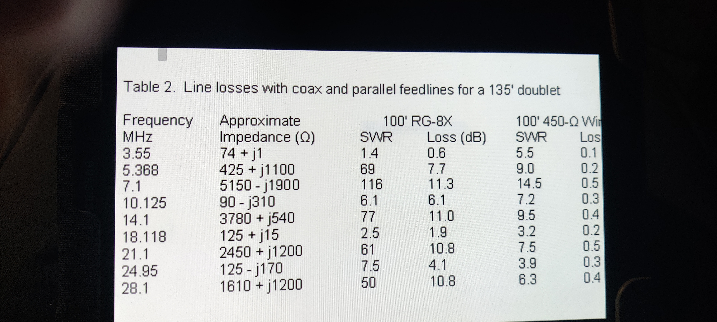
FEED LINE CHOICE
HAD 140 FEET SEPERATION FROM TREES AT BOTH ENDS OF THE LOT
MULTIBAND TUNED DOUBLET ANTENNA WOULD JUST FIT (135’)
THE MAIN DIFFERENCE OVER A DIPOLE IS IT IS FED WITH PARALLEL WIRE ( LADDER LINE )

Slide 7
INSTALLING WIRE ANTENNAS “GETTING IT UP AND KEEPING IT UP”
USING TREES IS A DOUBLE EDGE SWORD
GOOD HEIGHT AT BOTH ENDS
GOOD ACCESS FOR PLACING ROPE IN TREE
WIND AND TREE MOVEMENT CAN BE AN EXTREEM LOAD ON WIRE
CENTER OF ANTENNA OVER HOUSE
CHOOSING THE RIGHT SUPPORT ROPE. (THREE STAGES OF INSTALLING SUPPORT ROPE)
FIRST LINE 10-15 # MONOFILAMENT
MIDDLE LINE 1/16 TO 1/8 NYLON
ANTENNA SUPORT LINE
3/32 DACRON OR KEVIAR
3/16 OR 5/16 DACRON DEPENDING ON ANTENNA LENGTH
EXTERIOR STAND-OFF SUPPORTS (KEEP AWAY FROM METAL STRUCTURES)

Slide 8
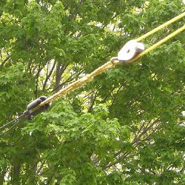
TWO SUPPORT LINE DEPOLYMENT SYSTEMS USED BY THE AUTHER OVER SEVERAL YEARS
GETTING SUPPORT ROPE OVER THE TREE
AIR LUNCH SYSTEM
AIR BOSS LAUNCHER
GAME TRACKER AND COMPOUND BOW (DANGEROUS IN NEIGHBORHOODS)
CHOOSING TO USE A PULLY SYSTEM OR ANT. WIRE DIRECTLY INTO THE TREE
A WAY TO GET THE ANTENNA DOWN FOR REPAIR . USE A “TAG LINE” ON INSULATOR

Slide 9
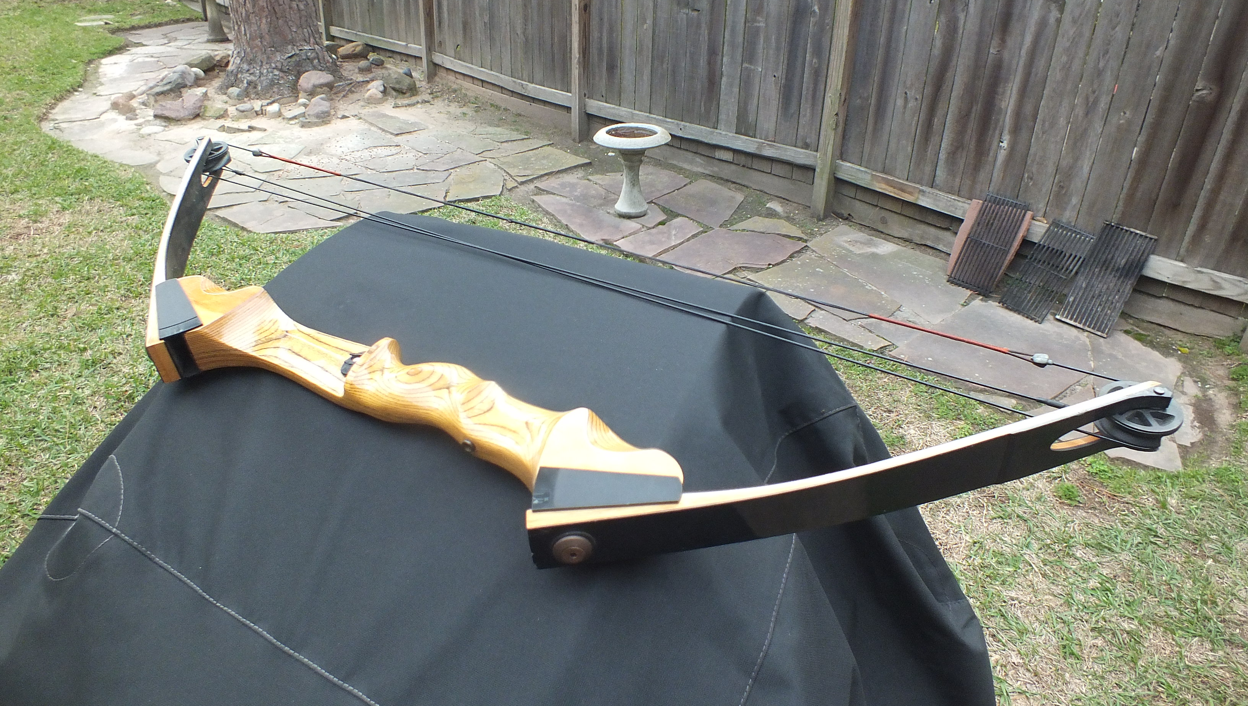
LAUNCH SYSTEMS
AIR LAUNCH SYSTEM
AIR BOSS LAUNCHER
GAME TRACKER AND COMPOUND BOW (DANGEROUS IN NEIGHBORHOODS)

Slide 11
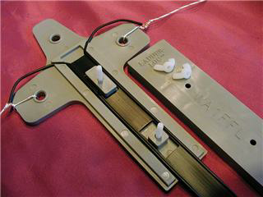
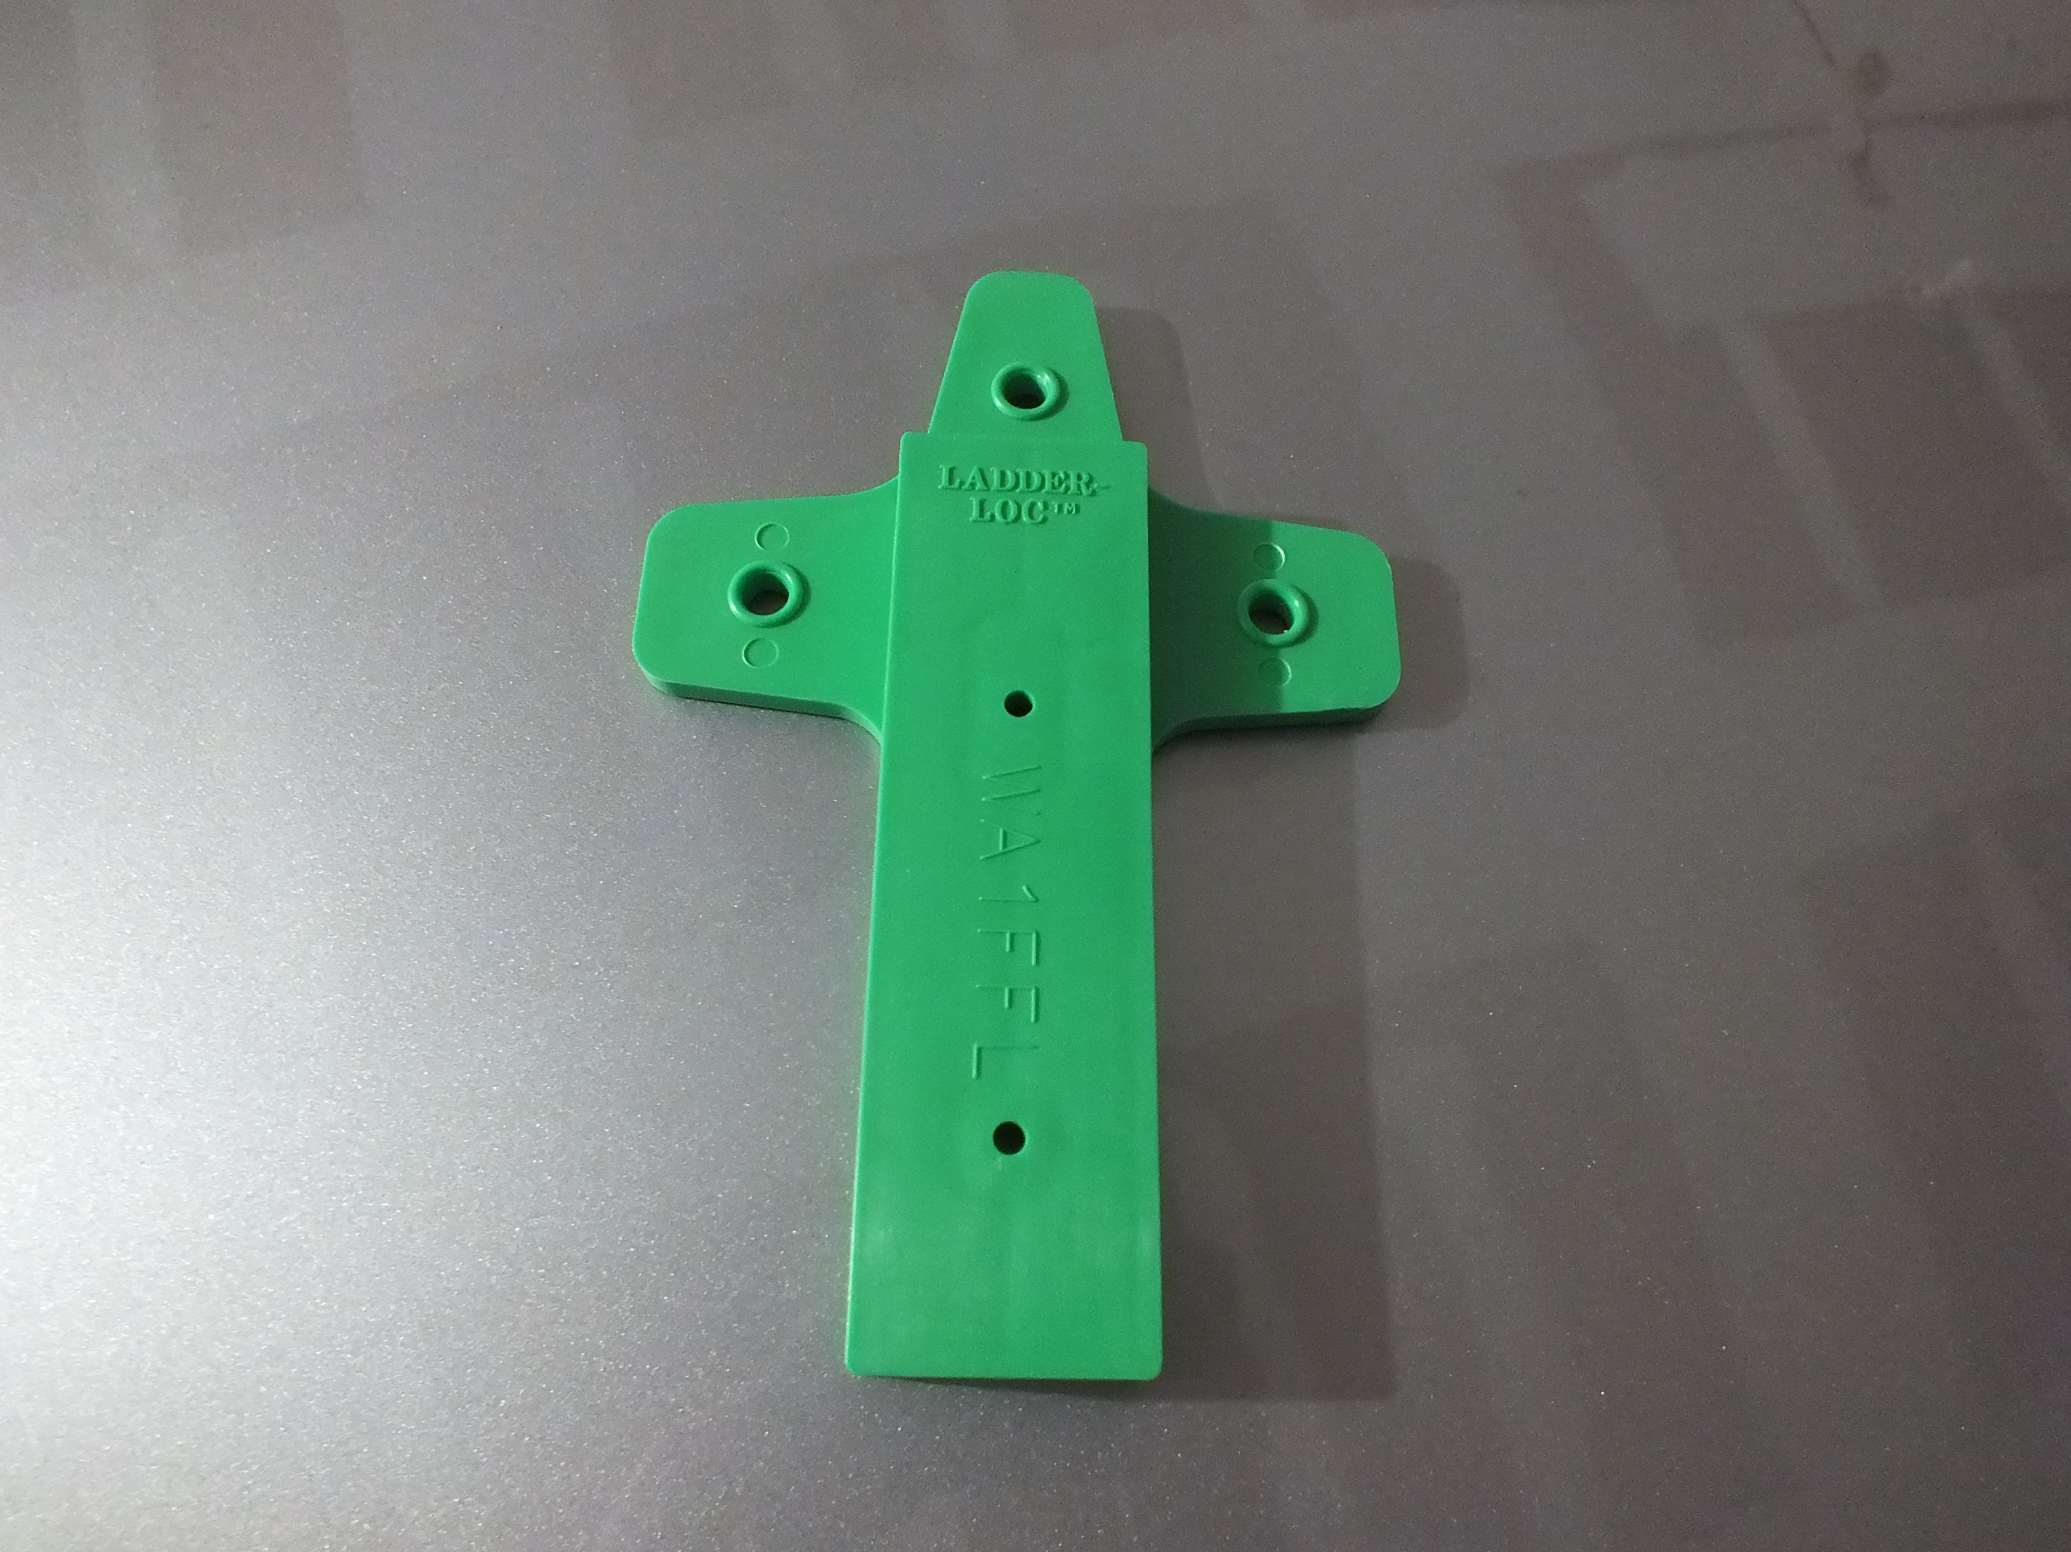
ANTENNA WIRE AND FEED LINE CHOICES BUY THE BEST IF YOU WANT IT TO STAY UP
USE TOUGH JACKET TYPE OVER FLEXIBLE STANDED WIRE
#13 VARIFLEX Insulated (19 strand) best in trees
#14 VARIFLEX Insulated ( 19 strand , copper clad )
LADDER LINE
450 OHM, # 16 19-STRAND WIRE ( SOMETIMES HARD TO FIND)
GET THE LOWEST GAUGE (largest diameter) AND STRANDED. STRANDED FLEX IN THE WIND UNLIKE HARD DRAWED COPER
USE A STRONG CENTER INSULATOR WITH GOOD SUPPORT

Slide 12
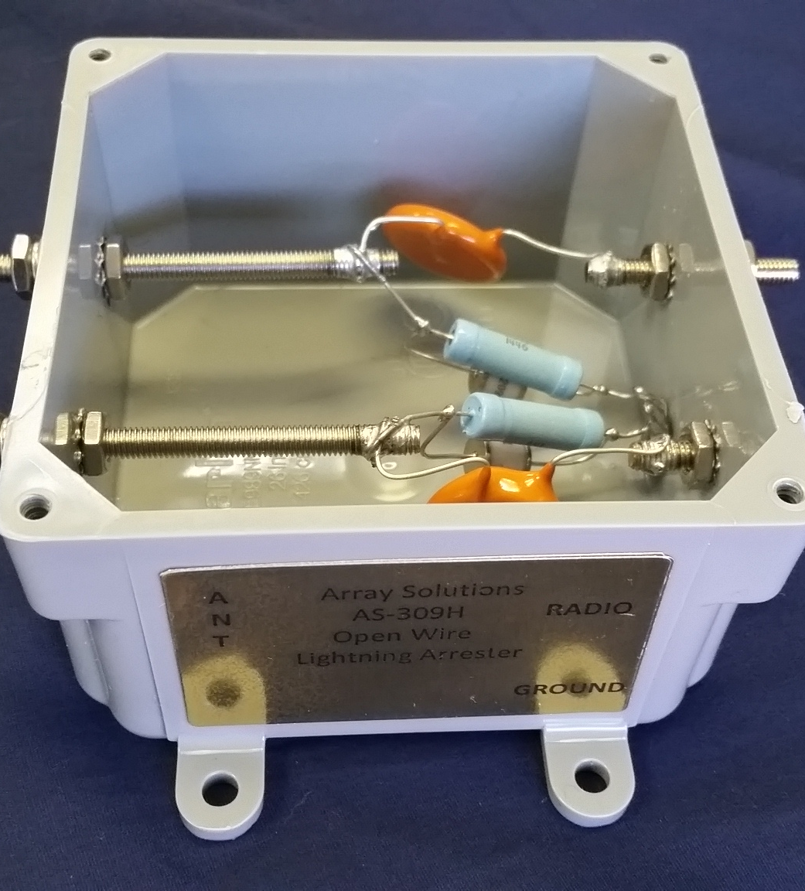
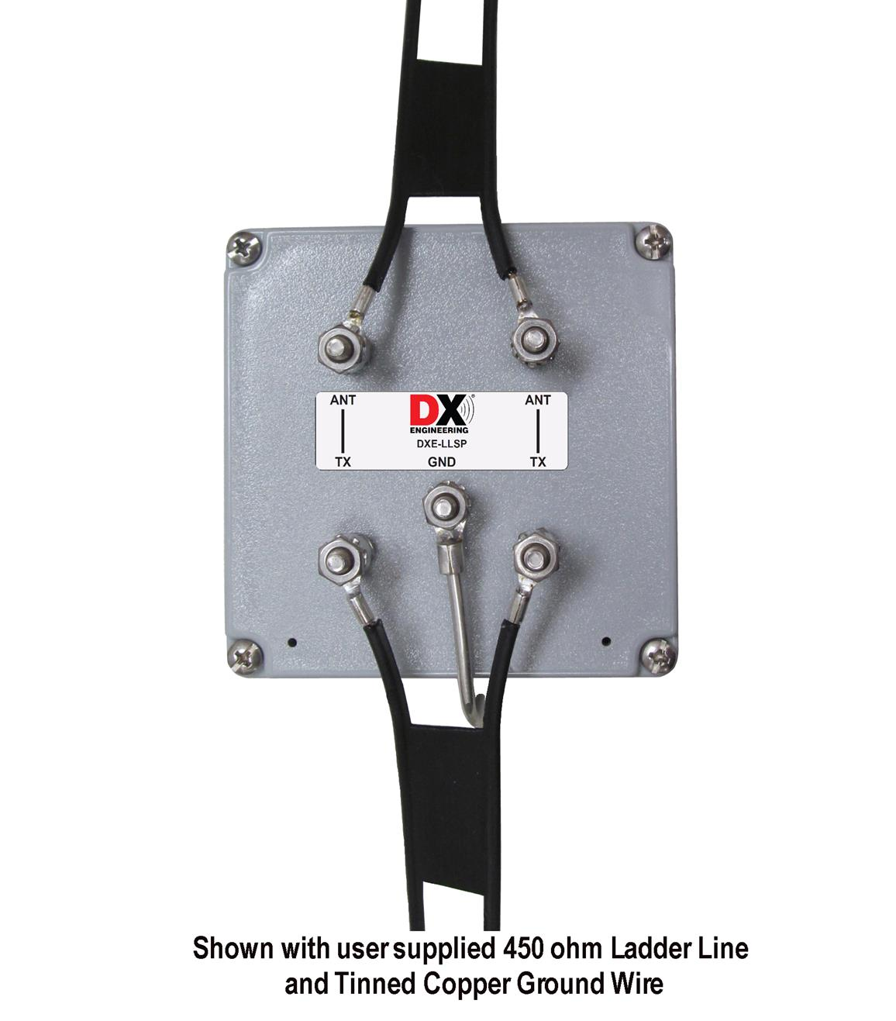
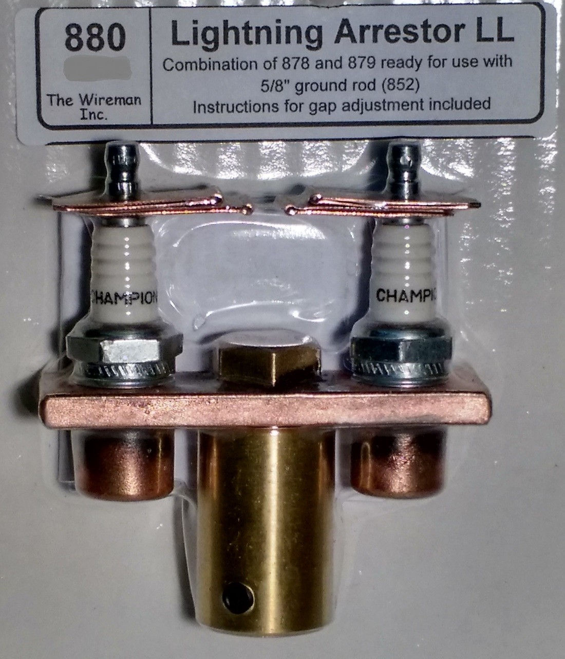
LIGHTENING PROTECTION FOR LADDER LINE
HOME MADE FROM ARTICLE BY ARRL HINTS AND KINKS, notes on lighting protection for open wire feed lines, illustrating the use of spark plugs with a 0.025” gap(1 Kw) to 0.045” gap ( > 1.5 Kw)
COMMERCIAL VERSION BY THE WIREMAN . Same technology but mounted directly to ground rod
DX ENGENERING LADDER LINE SURGE PROTECTOR DXE-LLSP . When the Device fails it opens feed line after strike . May not be apparent when this happens.
ARRY SOLUTIONS TWIN WIRE LINE SURGE PROTECTOR. If Device fails, it opens feed line after strike

Slide 13
ROUTING LADDER LINE INTO THE RADIO ROOM
COAX HAS THE BIG AVATAGE HERE
DISTANCE FROM 4:1 OR 1:1 CURRENT BALUN TO THE TUNER SHOULD BE MINIZED DUE TO HIGH SWR ON THE COAX….. AS MUCH AS 50% POWER LOSS AT 100 FEET
With ladder-line fed antennas, the balun should be located near the unbalanced tuner, keeping the coaxial cable between it and the tuner as short as possible. Avoid routing the ladder line parallel and close to other conductors or structures for any significant distance. ( Example: drip line & roof flashing, aluminized AC/heater ducts)
Feedline length with multi-band dipoles. Feedline length is critical to antenna tuning and performance. Always choose a feedline (connects the antenna to the balun, in this instance) that is 1/8th wavelength or some odd-multiple of 1/8th wavelength long on the low frequency . Lengths to avoid (in feet): 32, 65, 96, 130, and 260 - and multiples of any of those

Slide 14
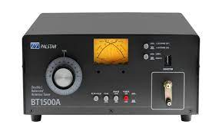
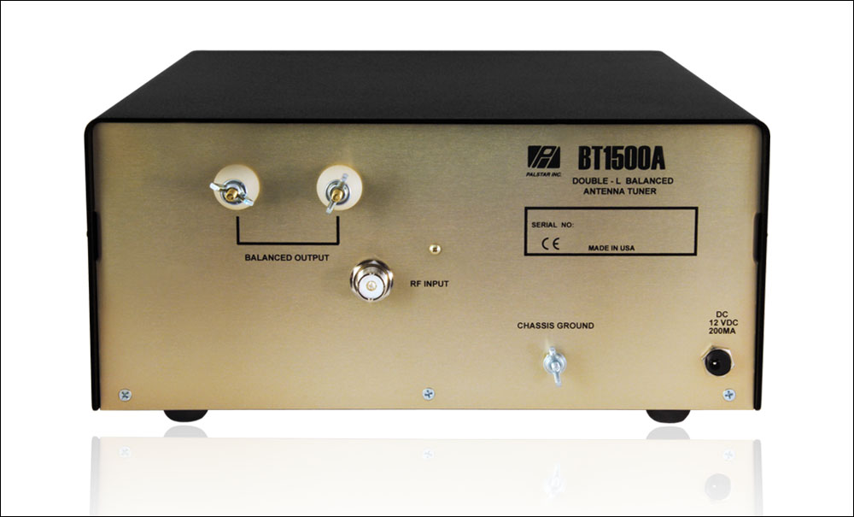
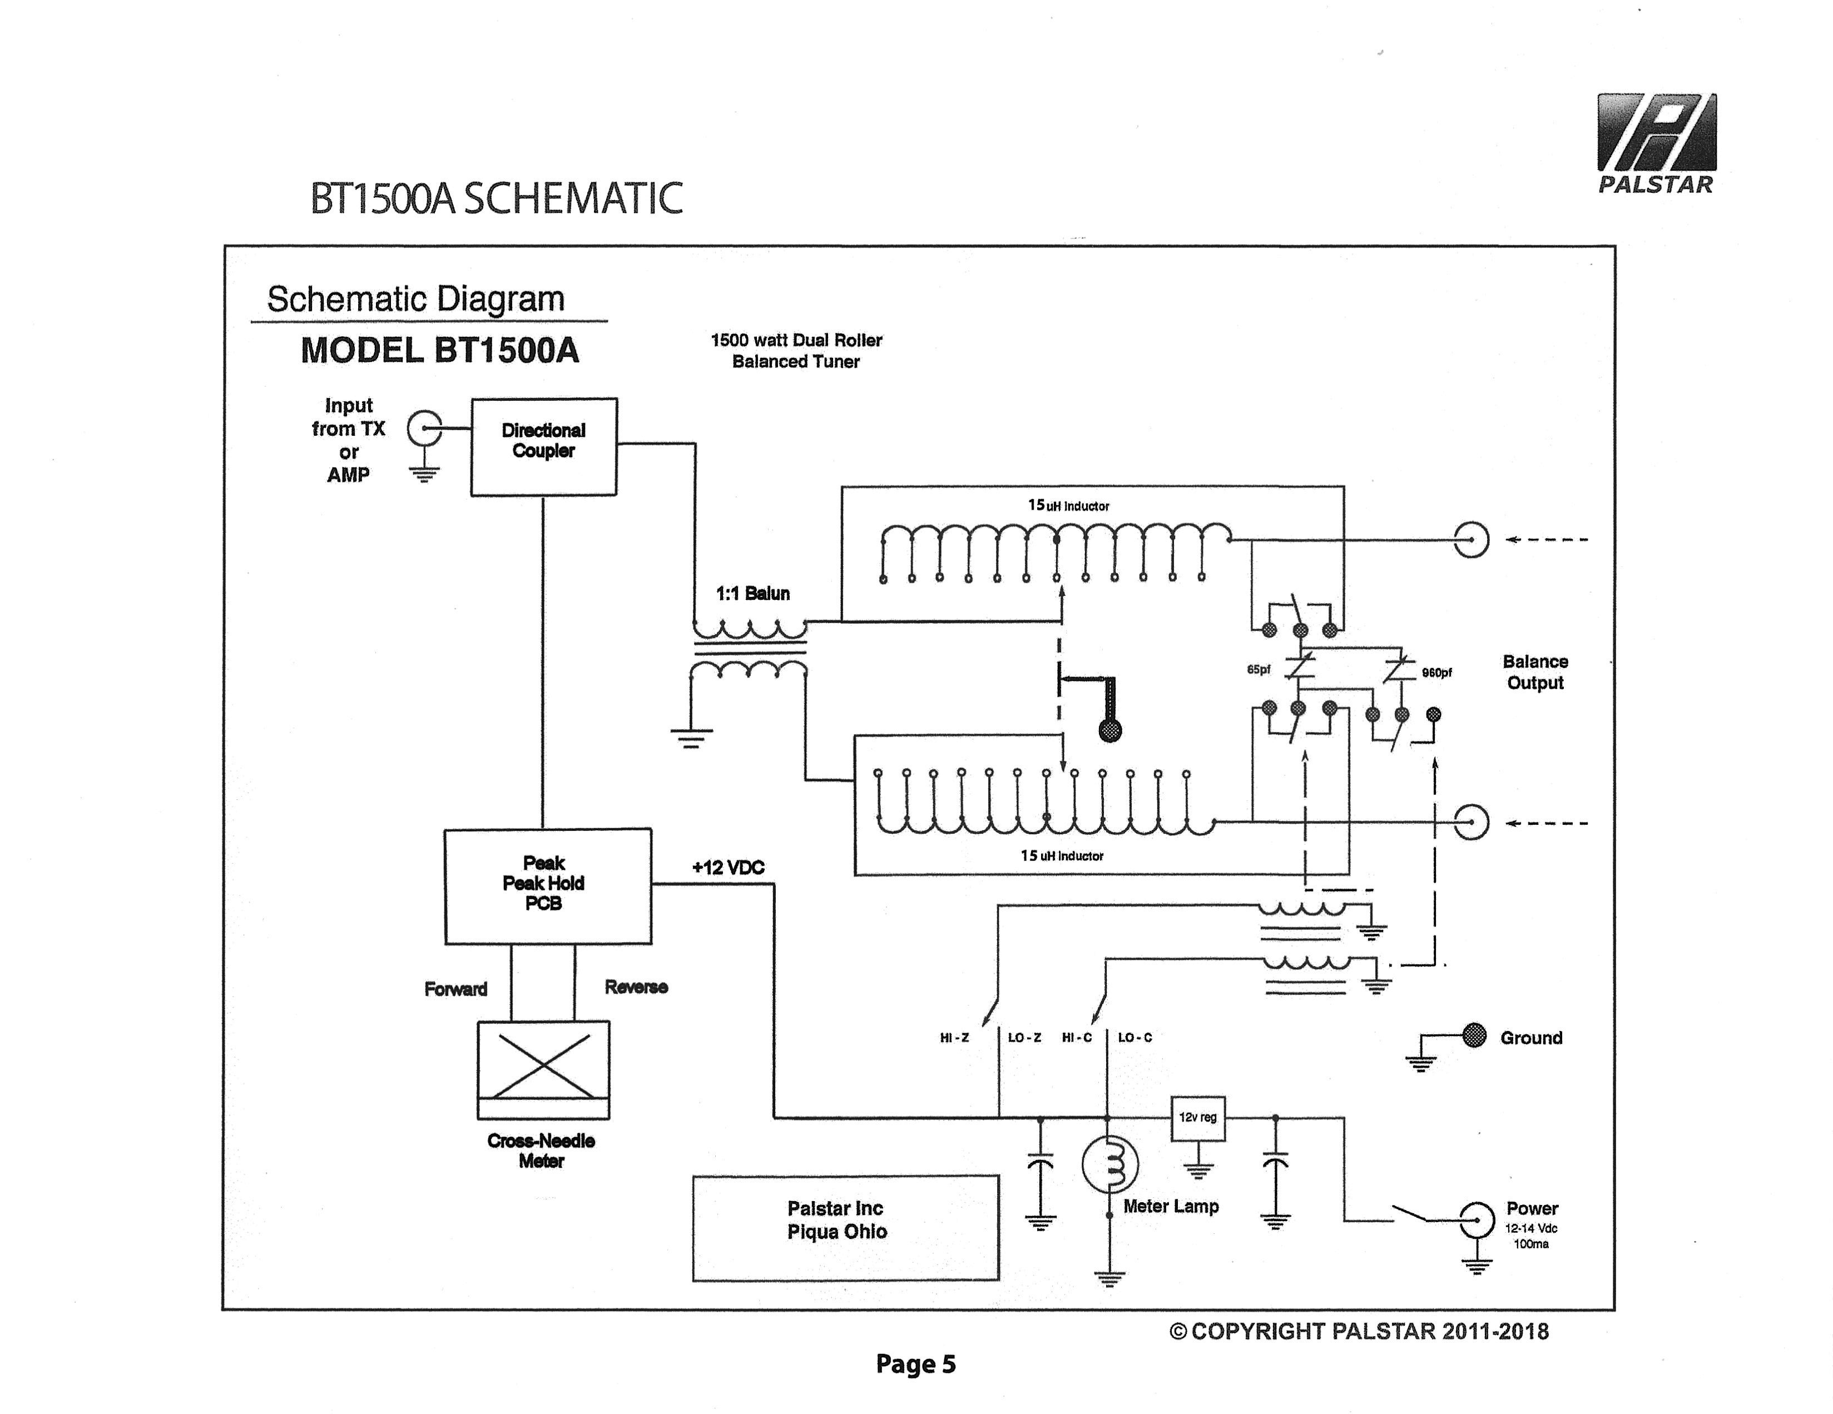
ANTENNA PROPERTIES AND MATCJHING ISSUES
A PROPERLY DESIGNED ANTENNA CAN OPERATE ON MOST FREQUENCIES AT WHICH IT IS A HALF WAVE-LENGTH OR LONGECAN PROVIED SOME SIGNAL GAIN AT HF FREQUENCIES (ELEVATION RADIATION PATTERN
FEED LINE DOES NOT MATCH THE IMPEDANCE OF THE ANTENNAS FEED POINT BUT THE PROPERIES OF THE PARALLEL WIRE FEED LINES MOVE THE ACTUAL FEED POINT TO THE LOWER END OF THE FEED LINE AT THE TUNER
WILL REQUIRE A BALANCED LINE TUNER
BEST CASE MATCHING FEEDLINE TO RADIO IS A BALANCED TUNER SUCH AS THE PALSTAR BT1500A ($950 @1.5 kW) , MFJ-974HB (300 WATTS) or MFJ 976 ($560 @ 1.5 kw)

Slide 15
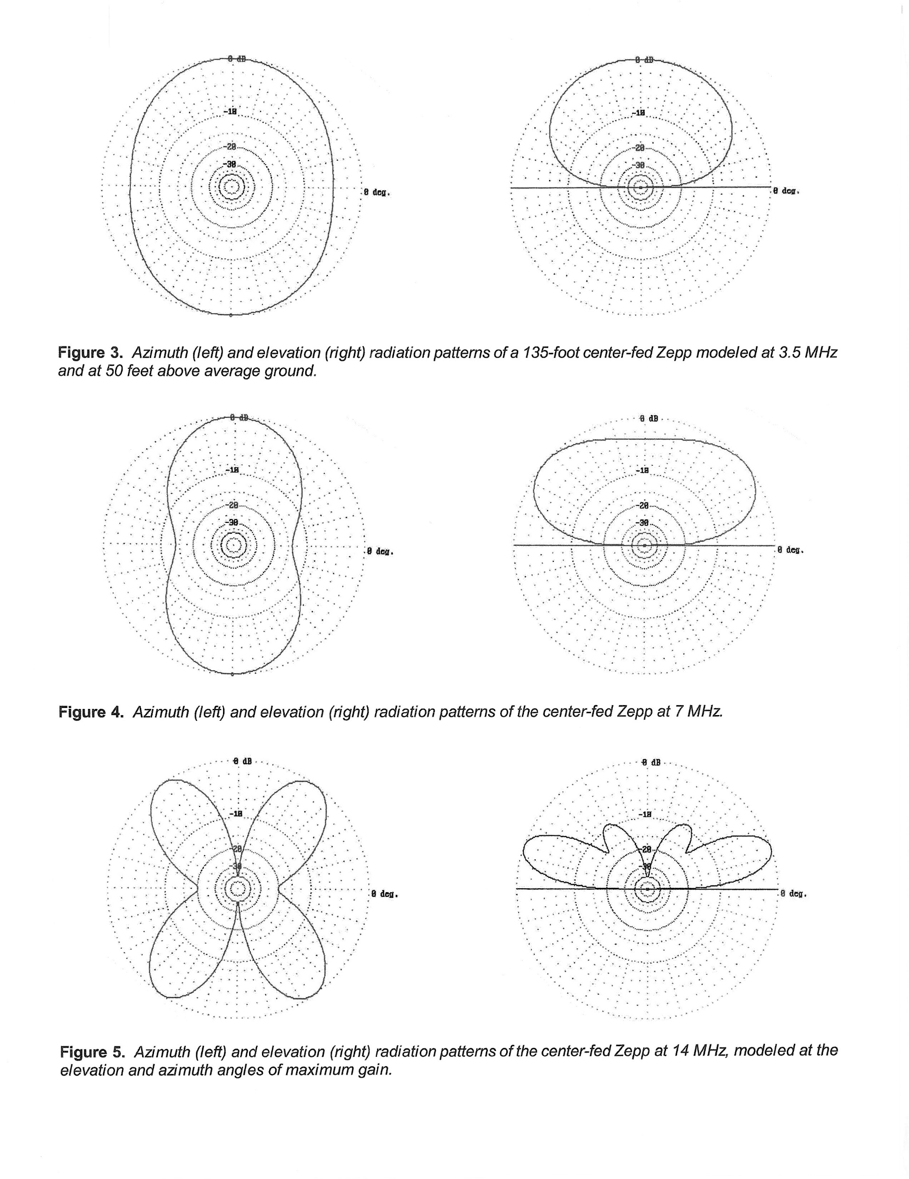

Slide 16
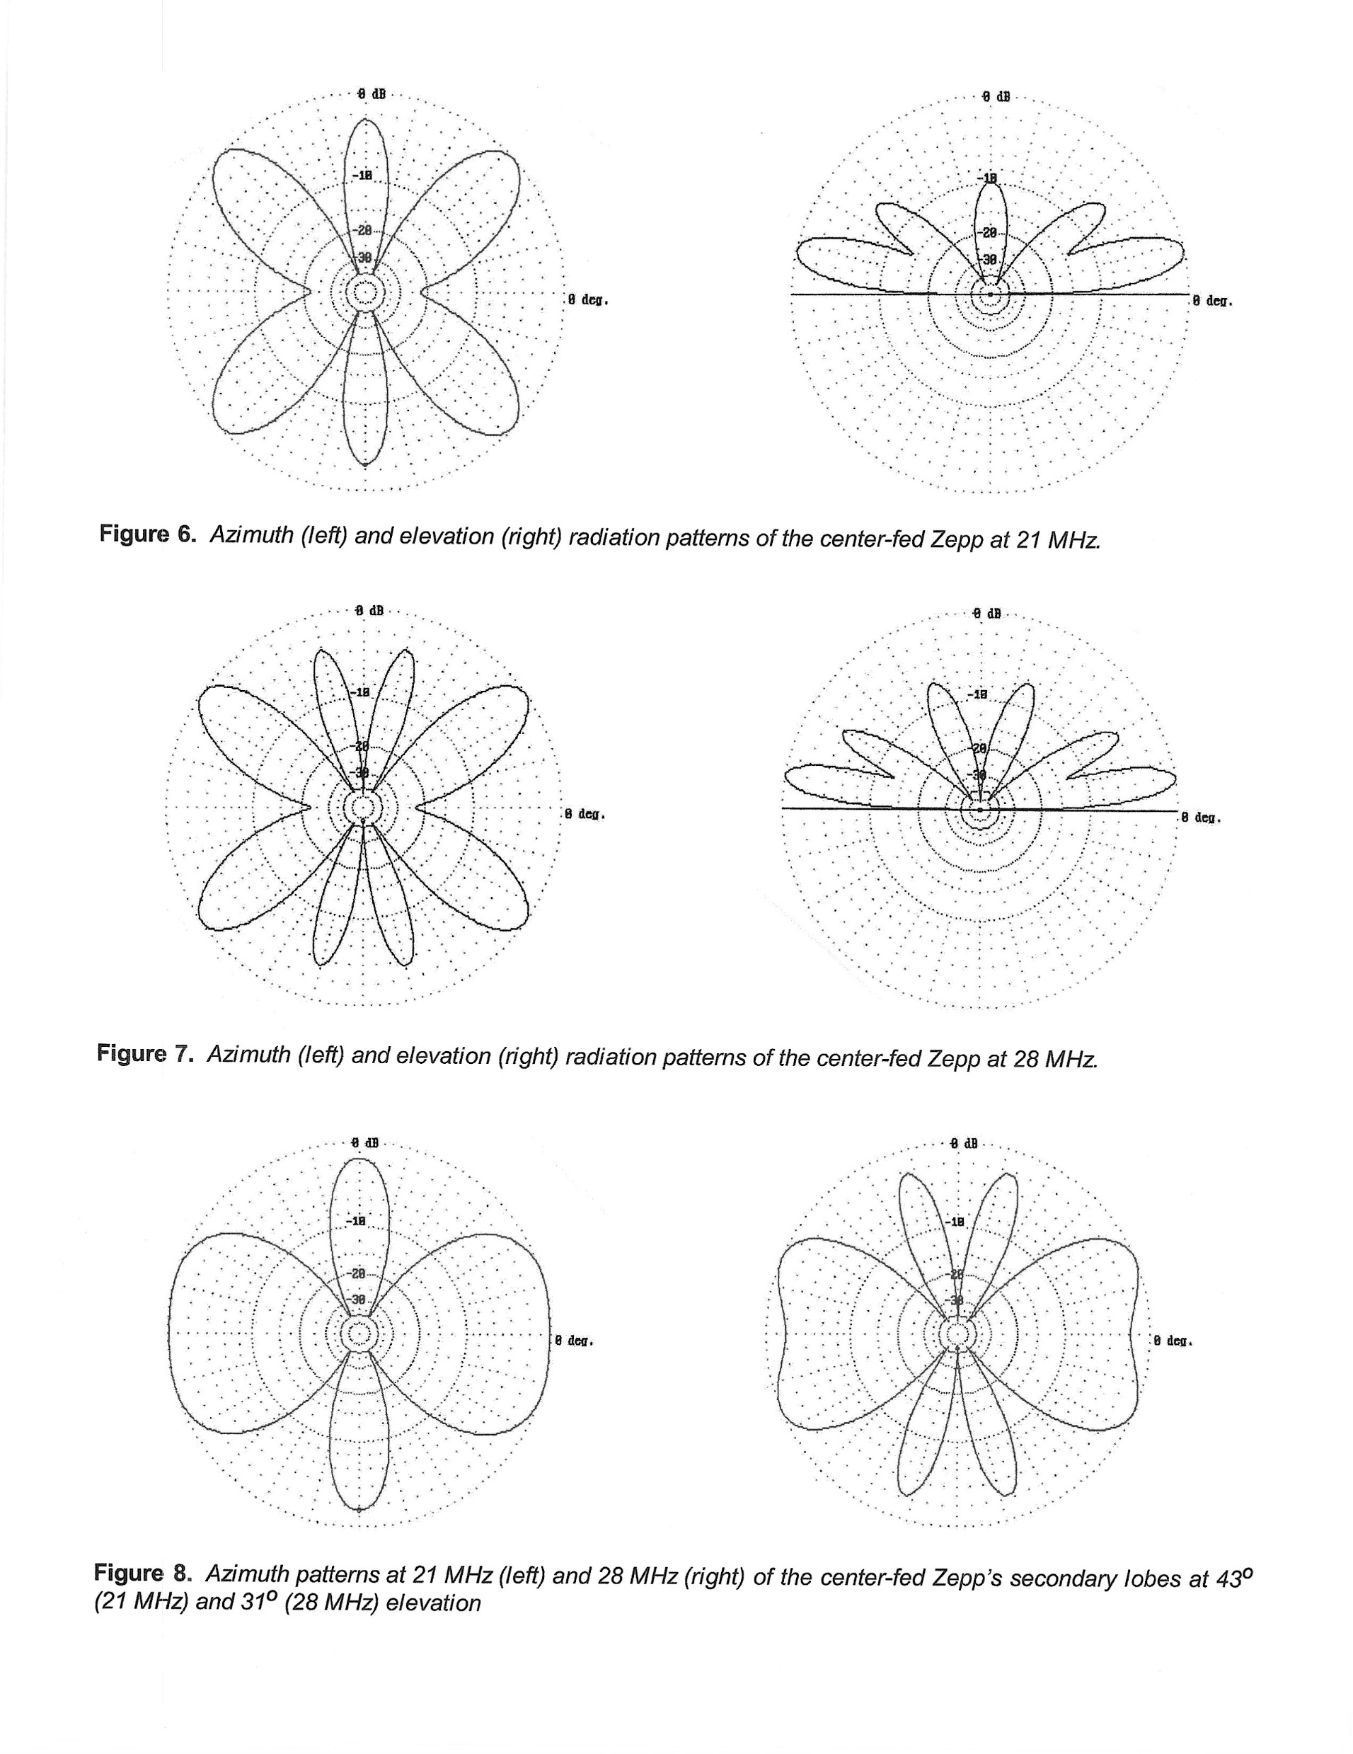

Slide 17
SUMMARY ARRL, November QST 1996
“The center-fed Zepp can be remarkably efficient, despite the relatively high SWR along its feed line. The secret is the ladder line's low loss, but the antenna tuner is another story. Tuner losses can vary widely with band, impedance mismatch, component quality and circuit design. A balun at the tuner output can be very lossy in this type of system.”
Advantages of the center-fed Zepp include all-band coverage, minimal weight and low cost
Disadvantages The expense of the tuner and the need to retune when changing frequency or bands. The radiation patterns becomes increasingly complex at higher frequency bands.
Ladder line lacks the convenience of coax. You must keep it away from metallic objects by at least twice its width—about two inches for one-inch-spaced 450-Q line.

Slide 18
Resource Credits
ARRL Hints and Kinks, Notes on Lightening Protection for open-wire Feed Lines
ARRL NOVEMBER 1996 QST Lab Notes
The Radio Works , reference catalog, Jim Thompson W4THU (sk)
Douglas Campbell, N1CWR, The Multiband Tuned Doublet Antenna December 1999
The Radio Room, article by AJ8MH, December 2011.

Slide 19
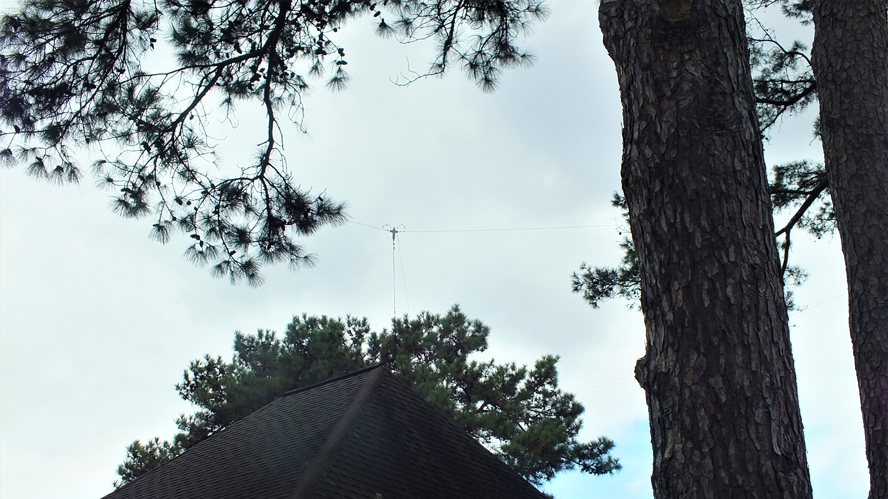

Slide 20
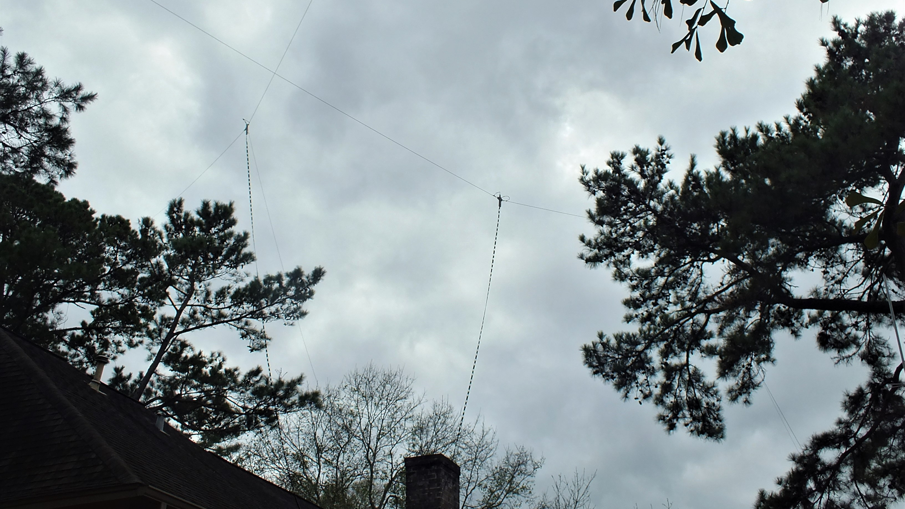

Slide 22
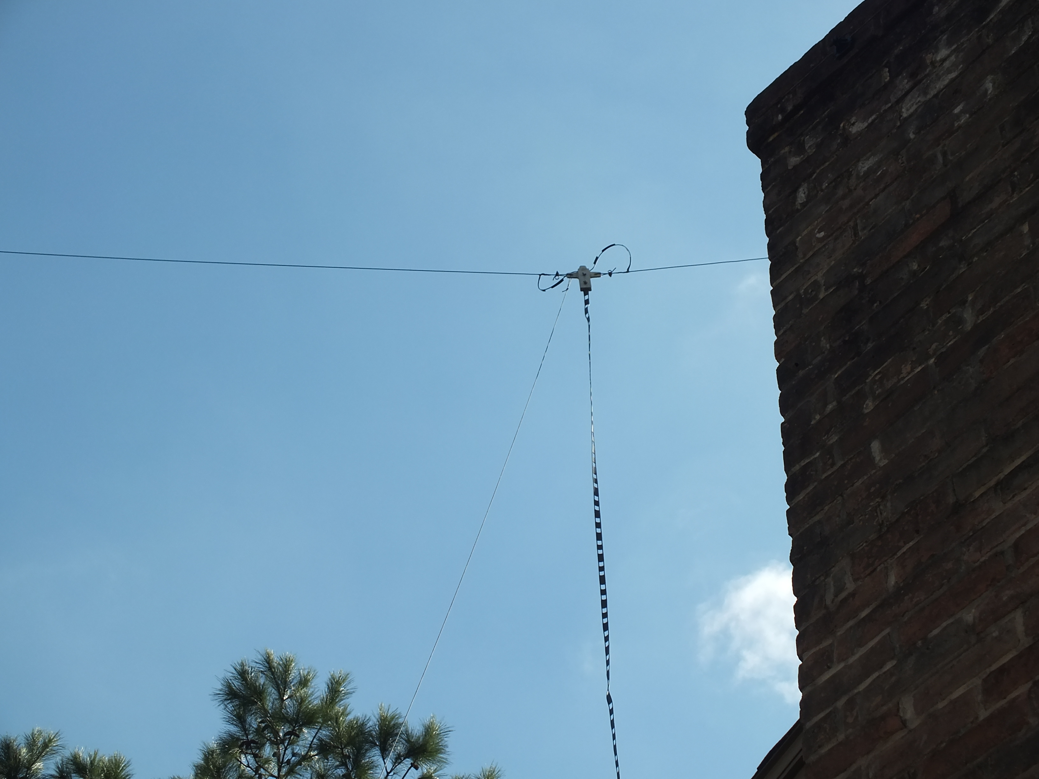

Slide 23
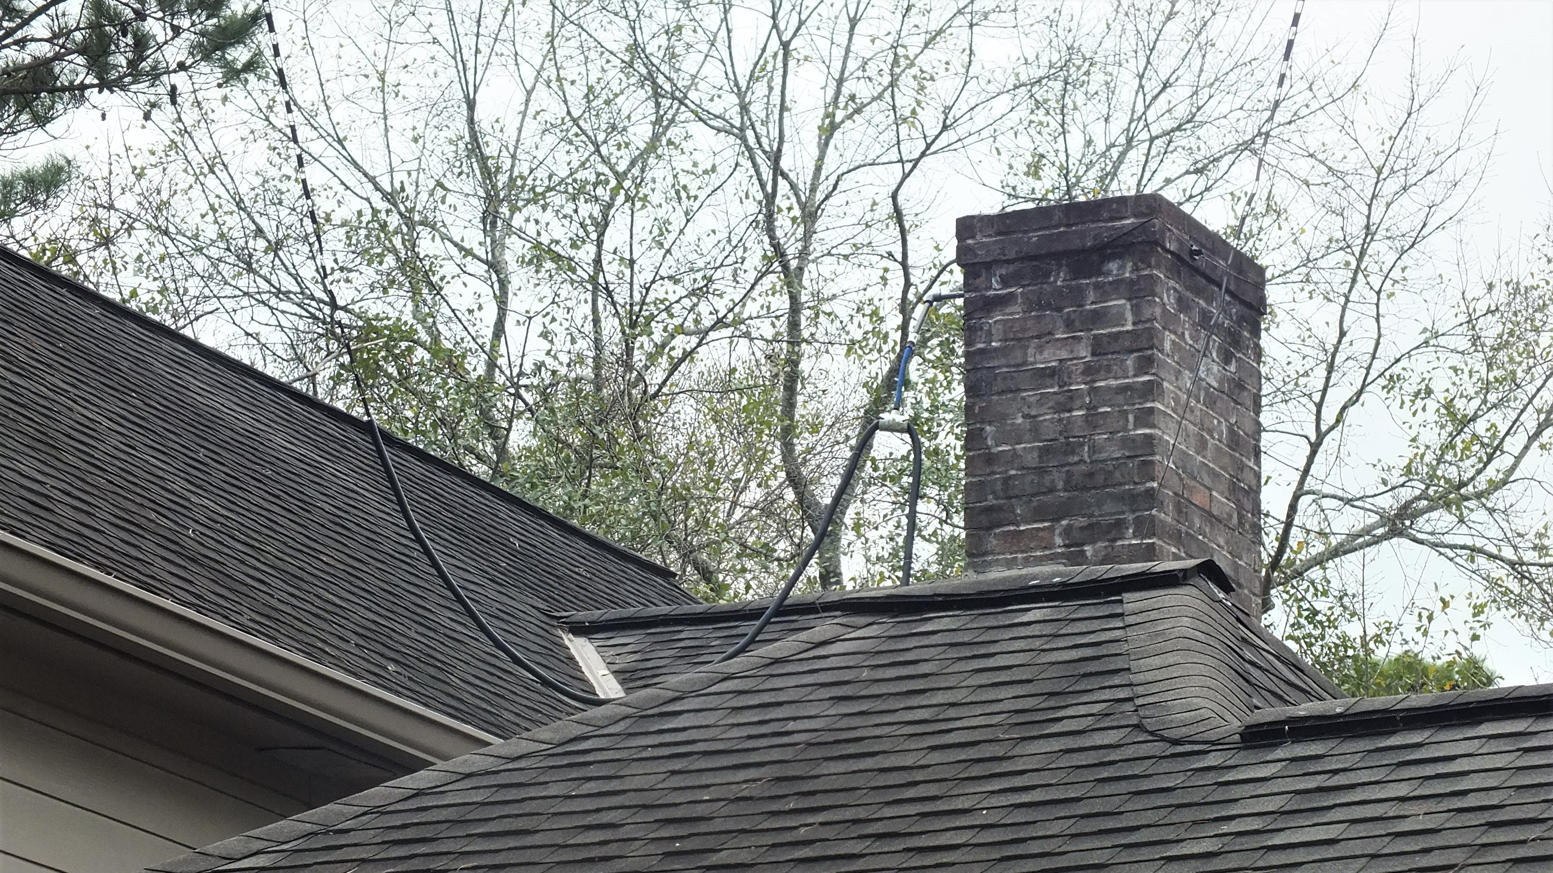

Slide 24
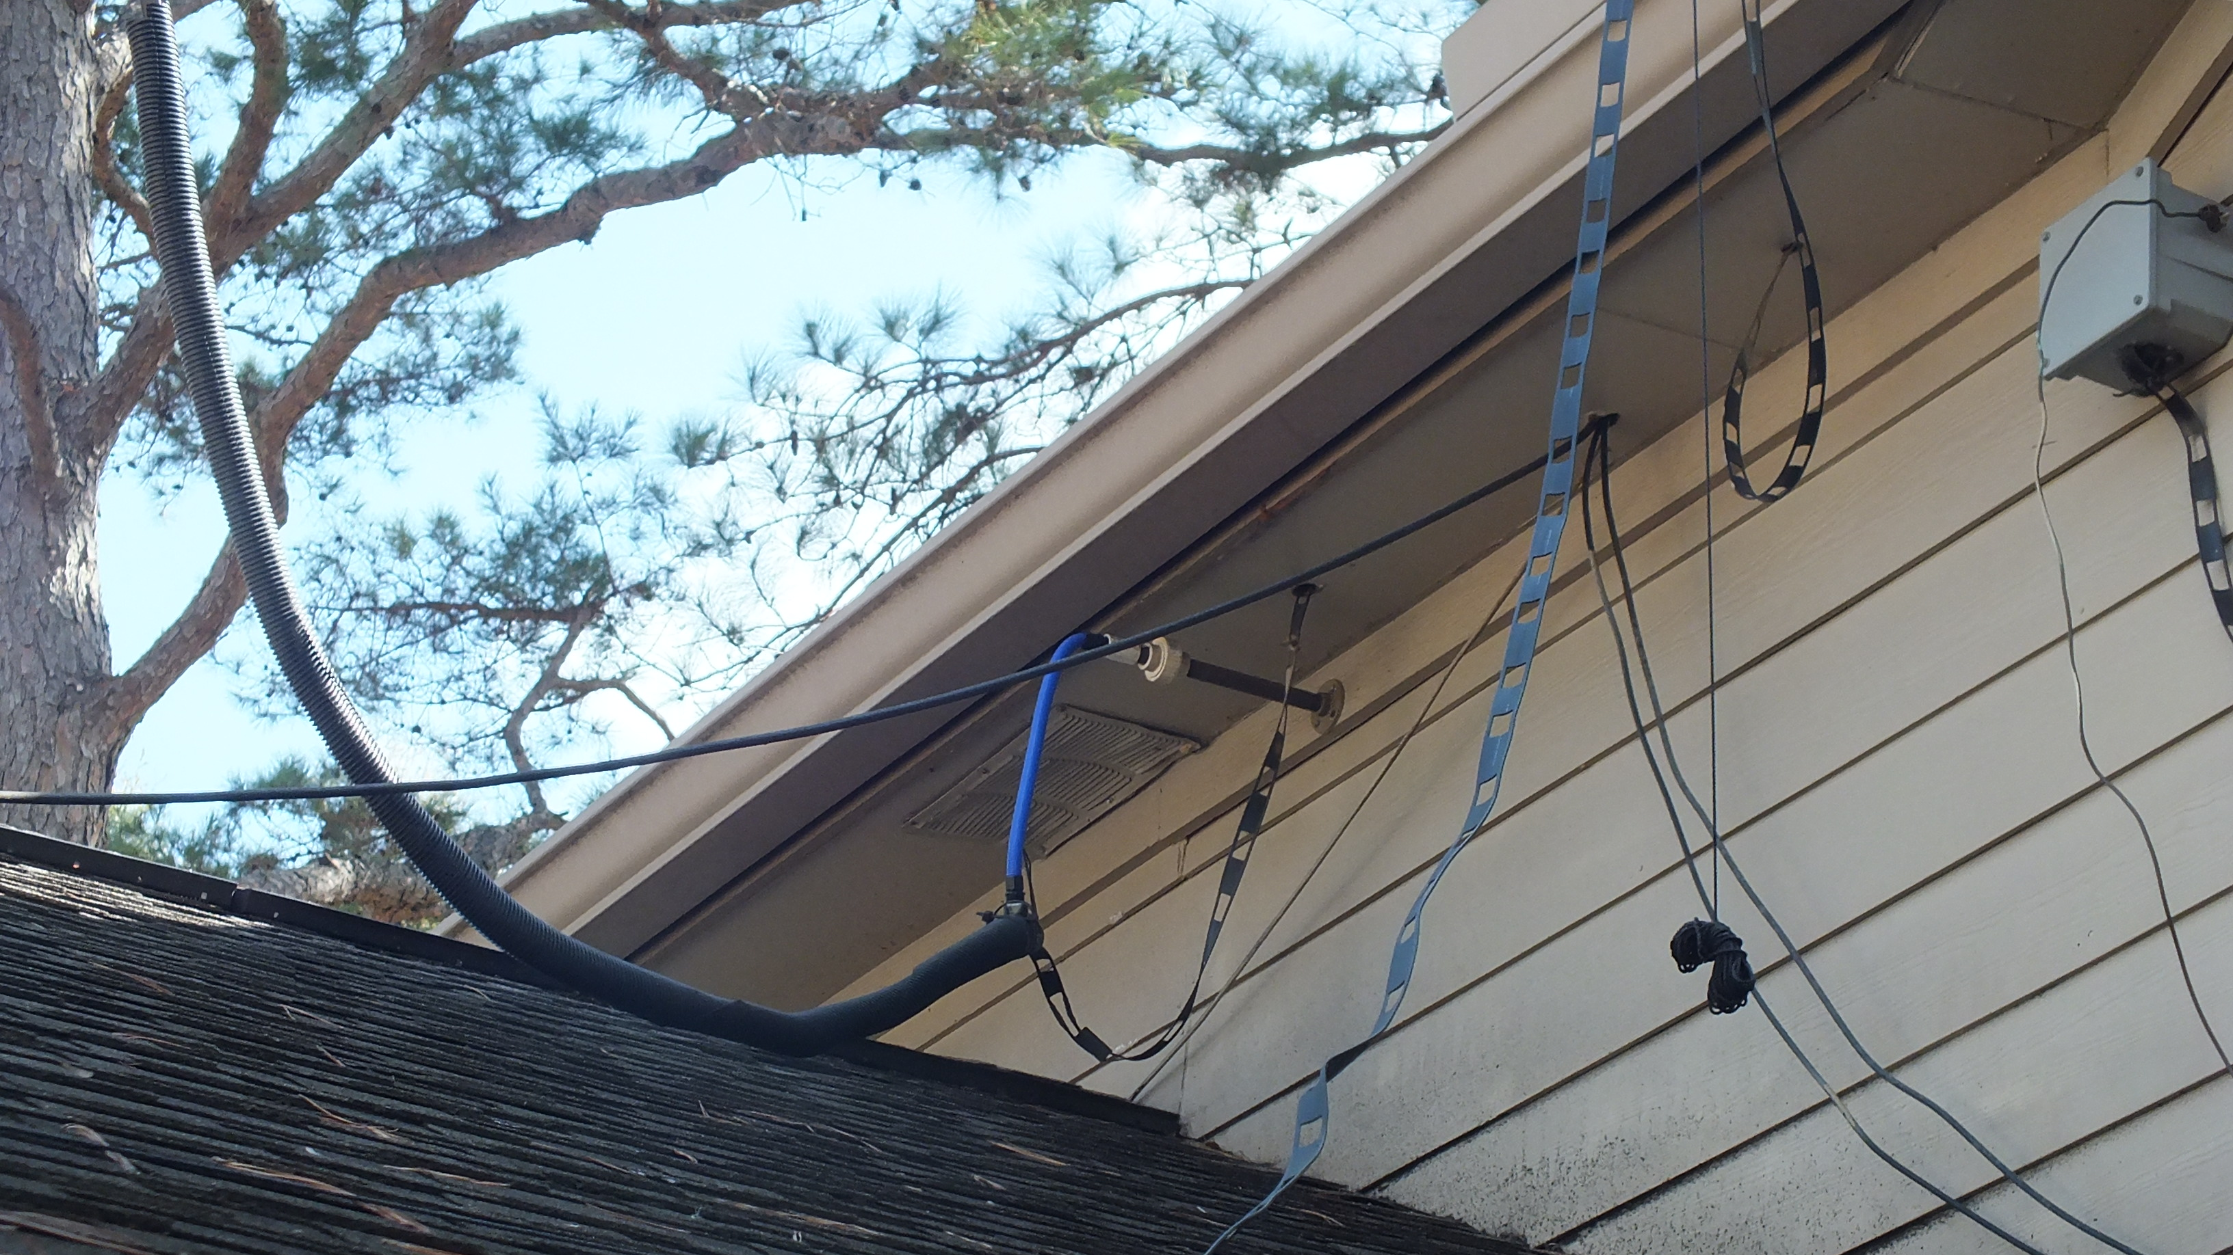

Slide 25
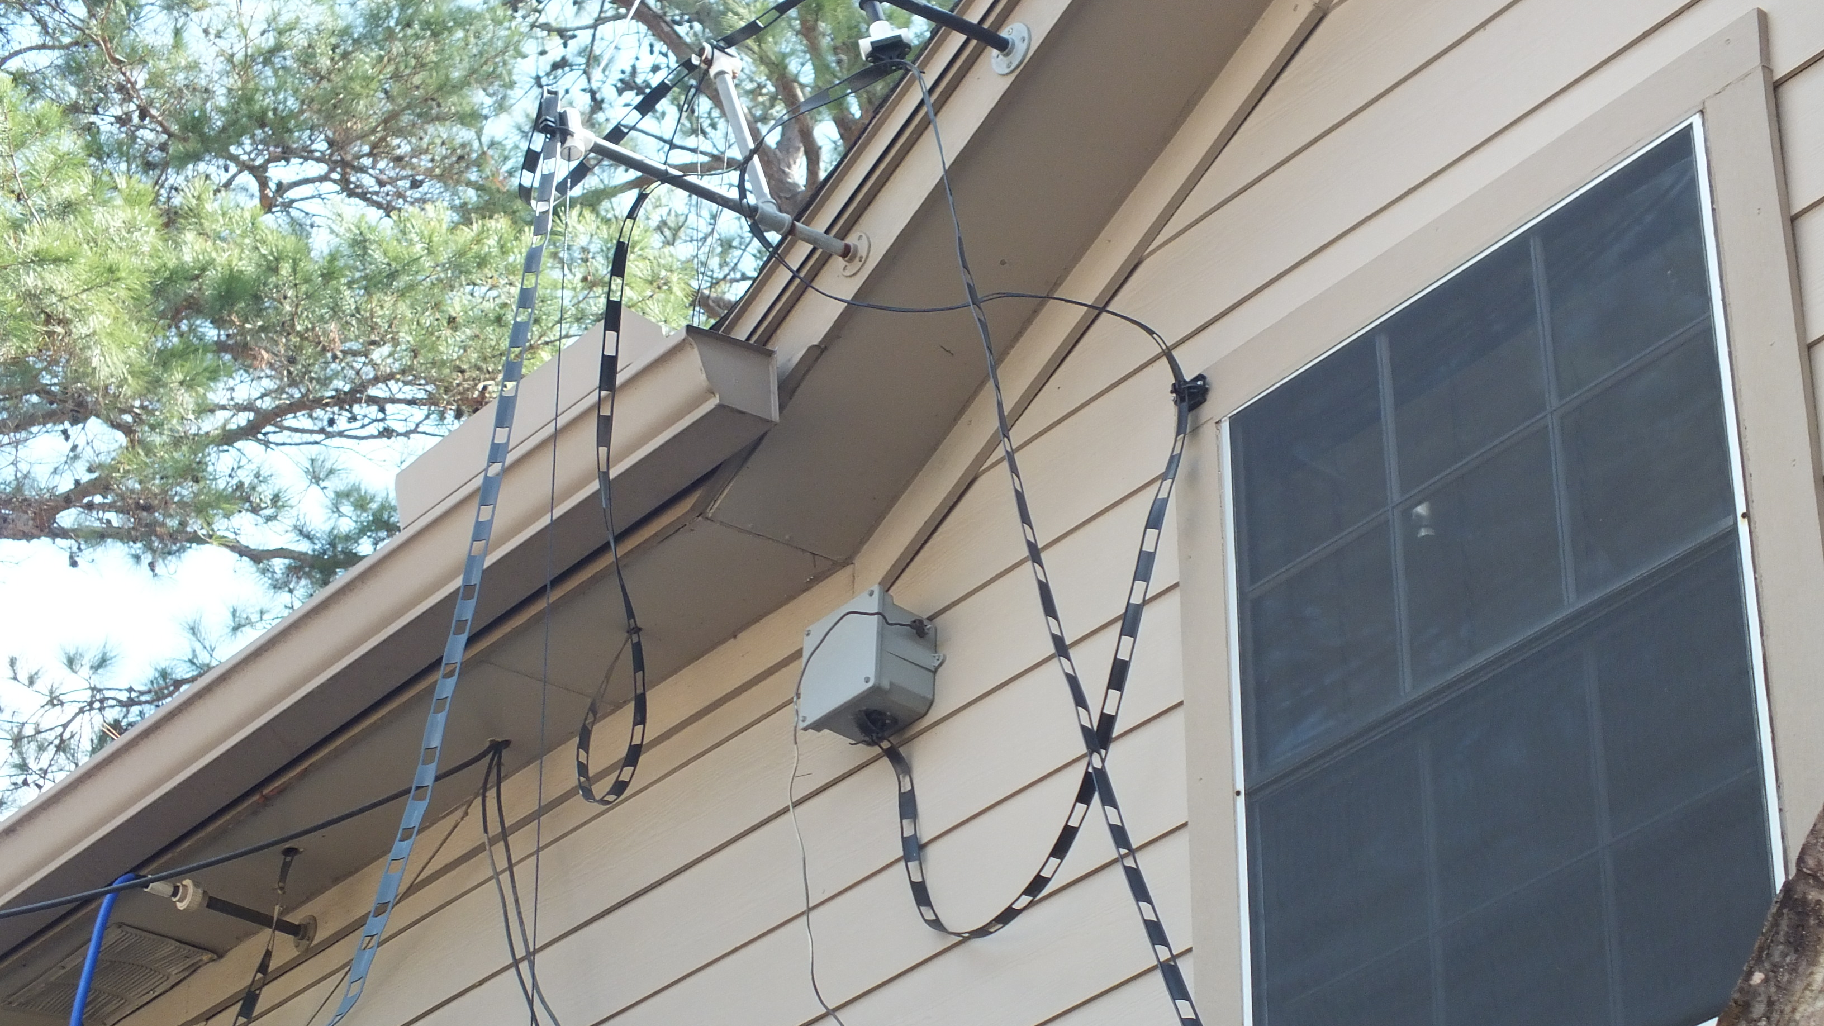

Slide 26
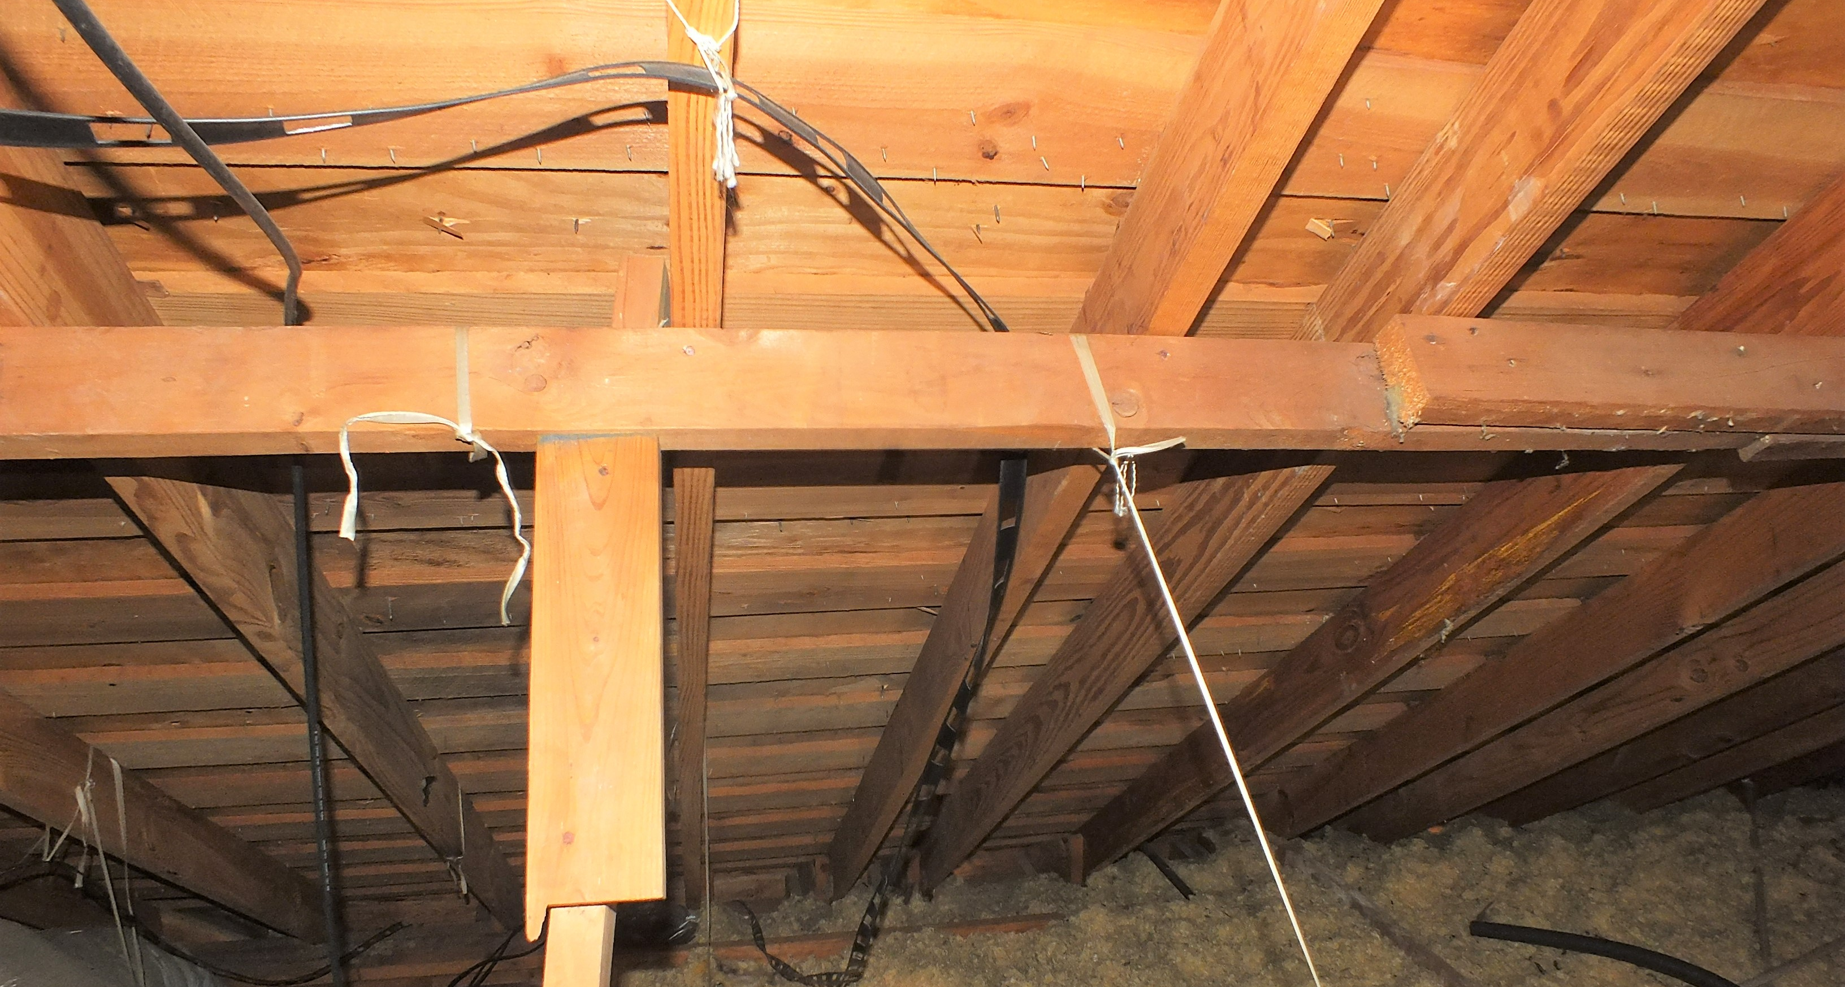
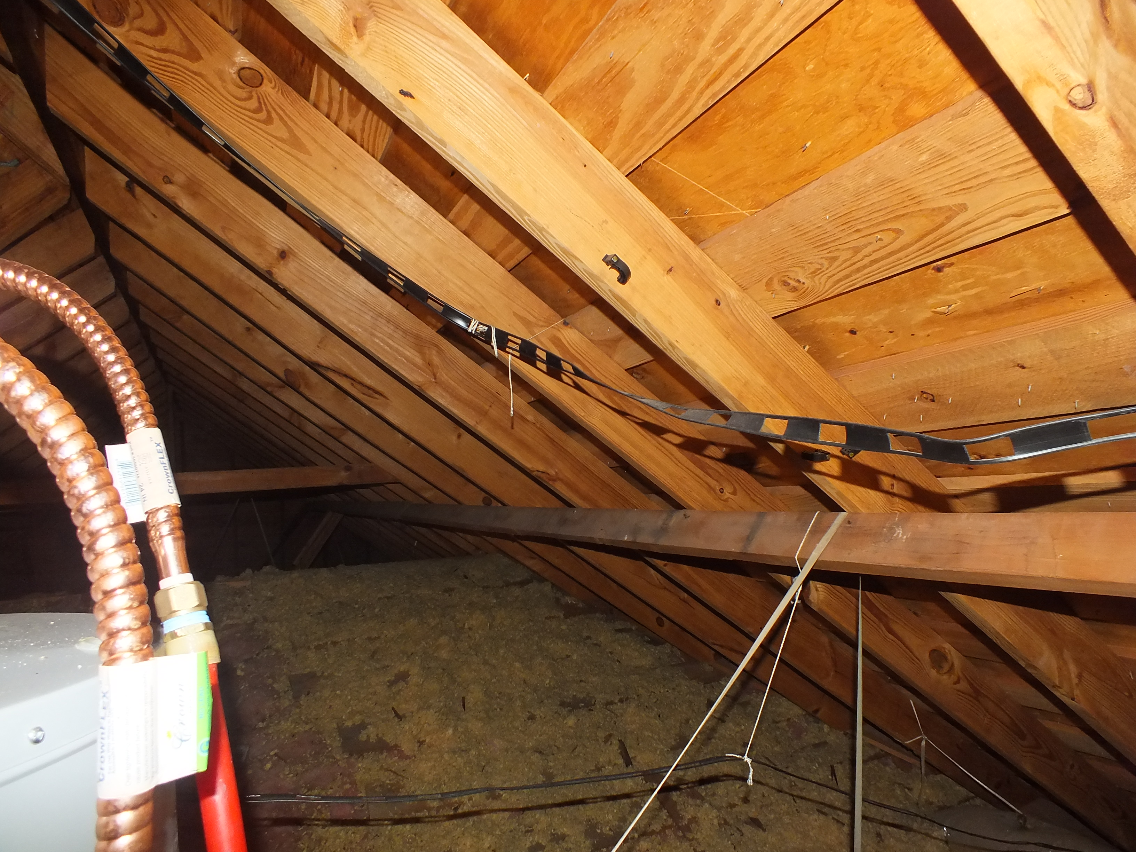
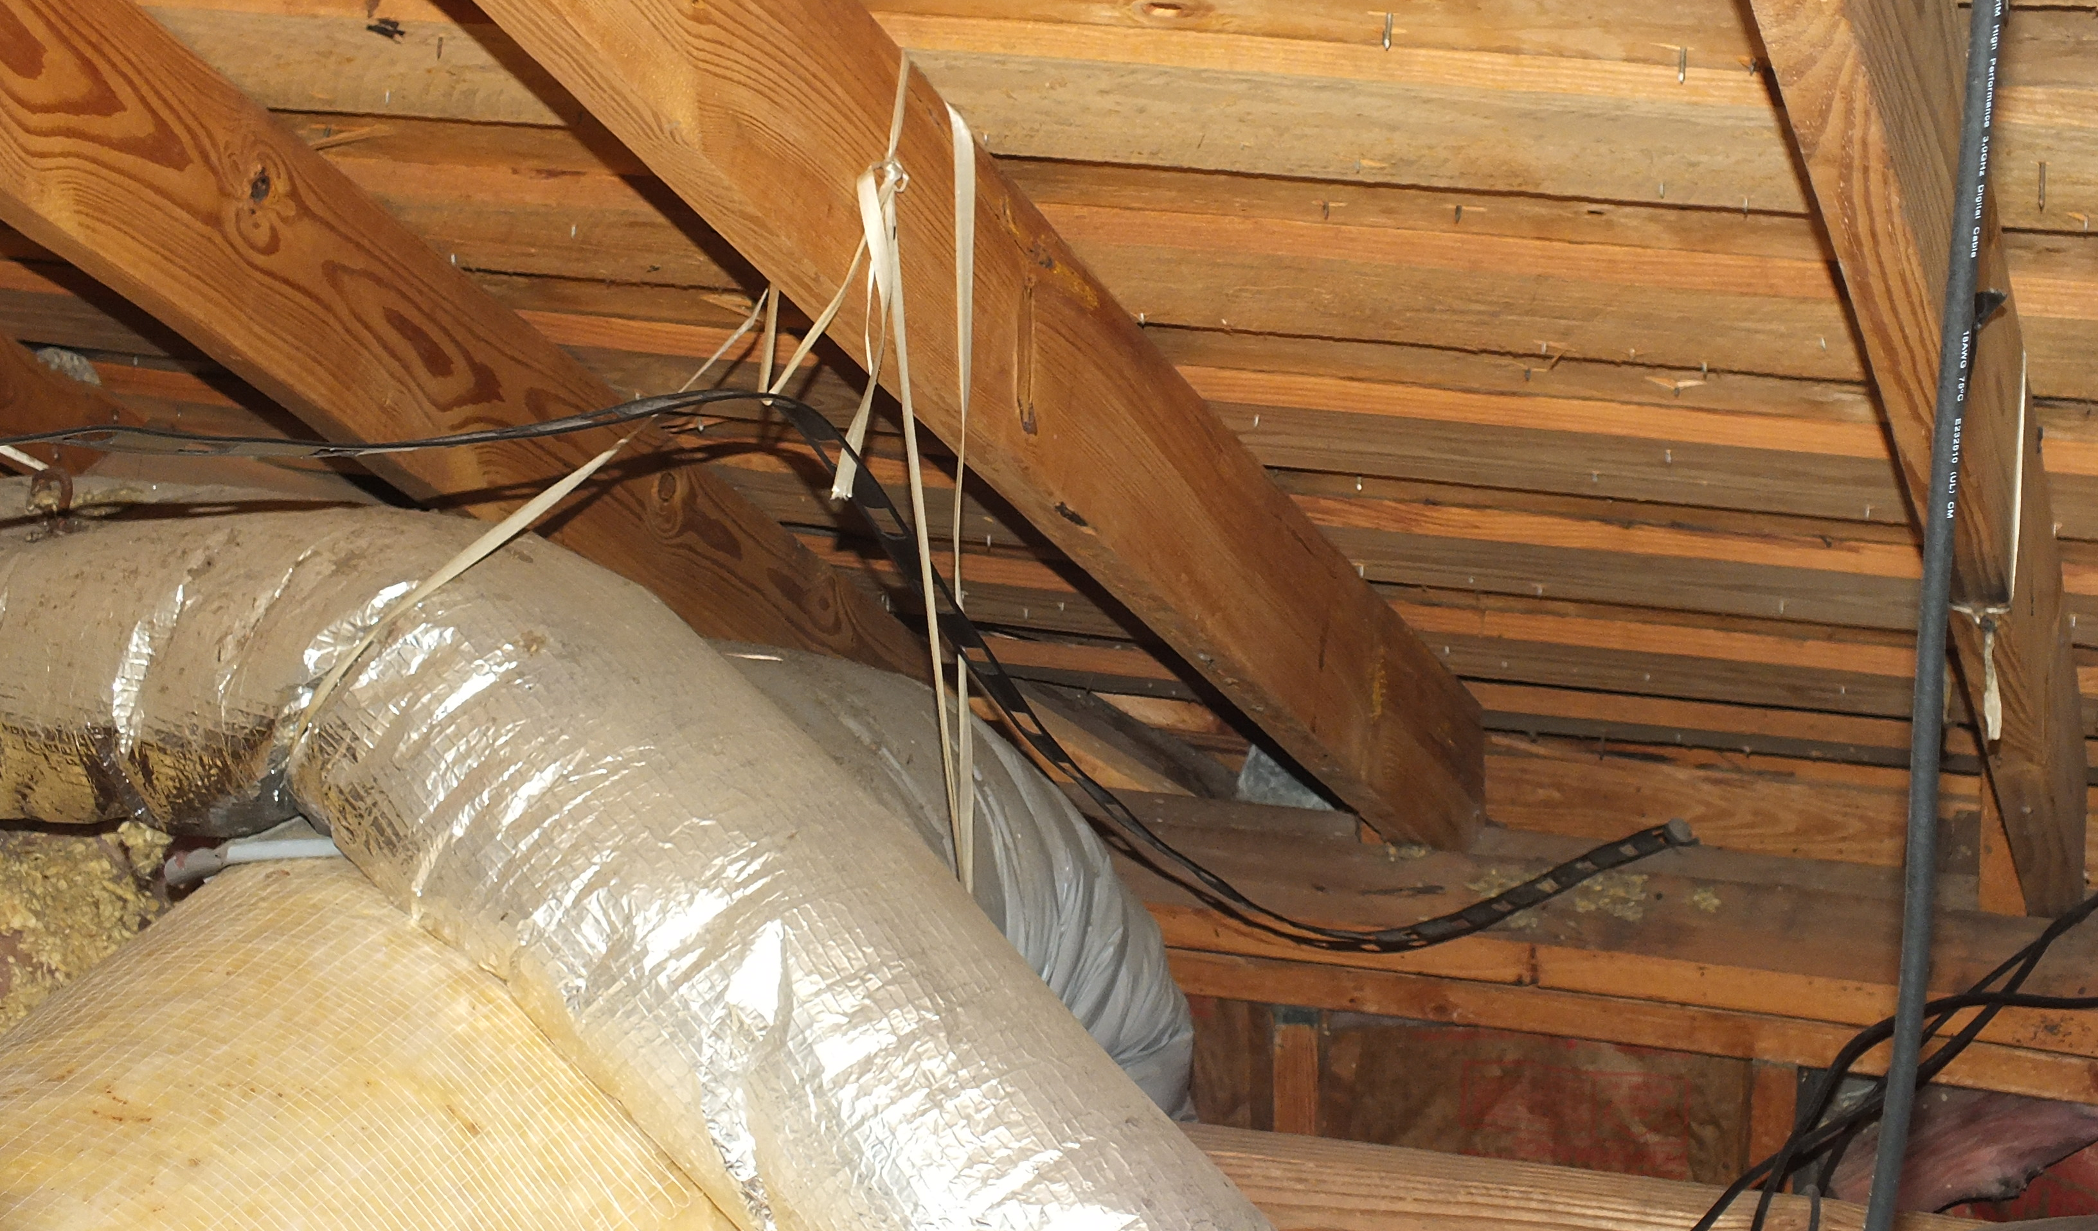
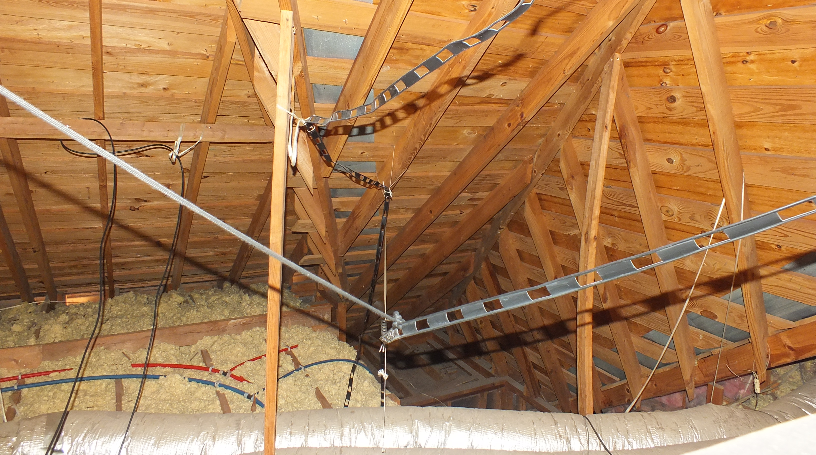

Slide 27
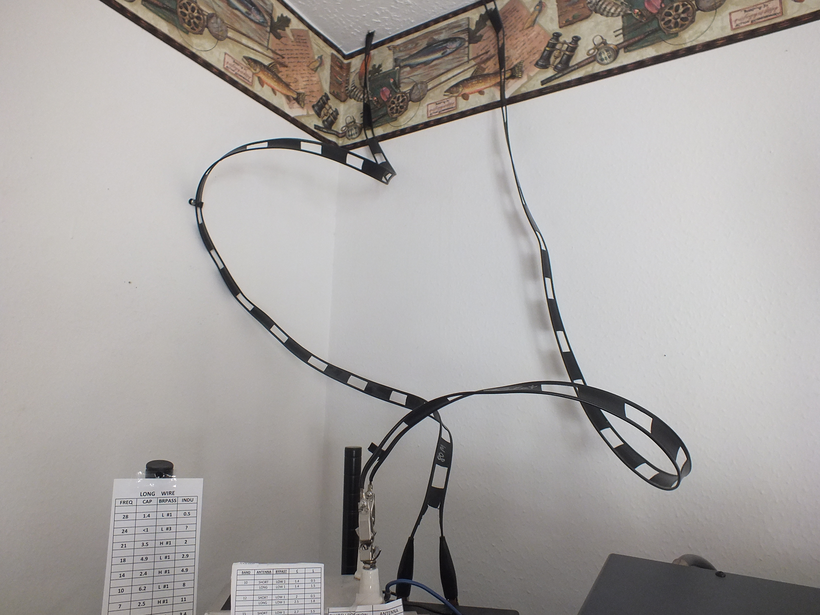

Slide 28
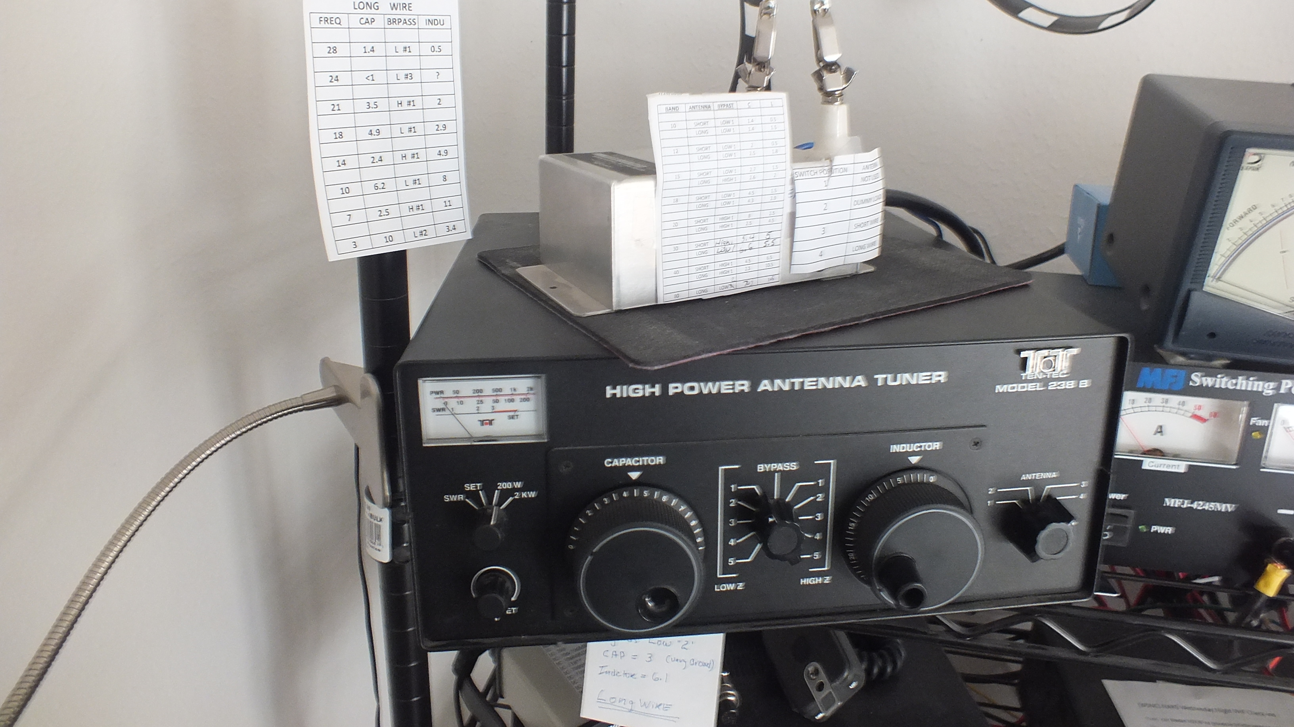

Slide 29
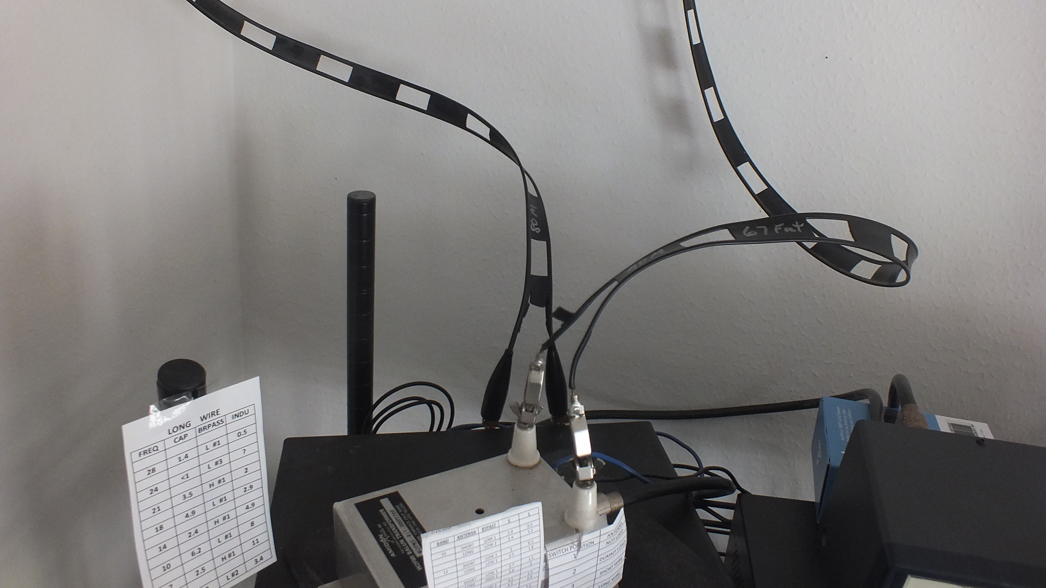

Slide 30
